Slide 1


Exploration of seismic data interpolation using Radial Basis Function (RBF)
By
Hambal Tella
Damilola Olawoyin-Yussuf
EE 562 Term 212

Slide 2



Agenda
Introduction
Problem Statement
Implementation
Results
Remarks

Slide 3
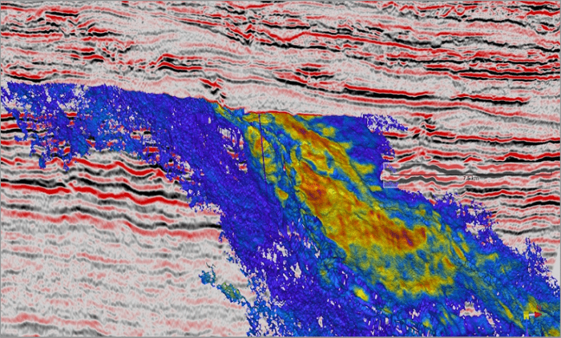

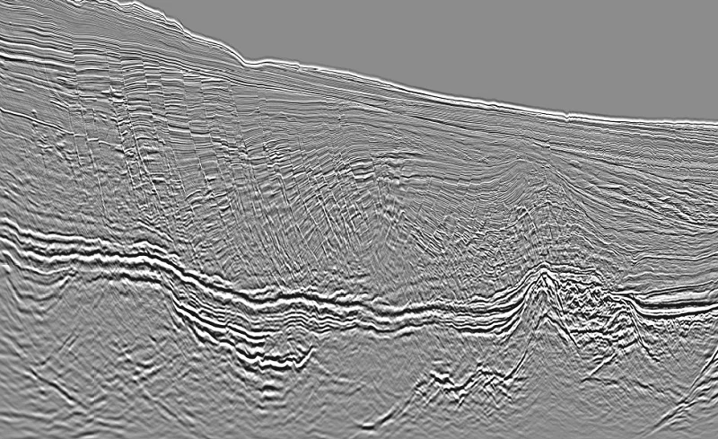


Introduction
Notes:
Image Source: https://www.offshore-technology.com/news/tgs-pgs-release-seismic-data-results/

Slide 4

Introduction
CURRENT METHODS IN SOLVING RBF
Fast multipole method
Multilevel method
Conjugate gradient method
Gaussian
Polymorphic splines ( Thin plate)
Multiquadric
Cubic
Linear
Wendland (Compactly Supported Radial Basis Functions)

Slide 5

Problem Statement

Slide 6
Problem Statement
Applications
Reflection Seismology Method
Drawbacks
Oil and Gas Exploration
Location of groundwater, landfills
Characterize how an area will shake during an earthquake
Involves the generation of artificial seismic waves and the recording of their reflections from different geological layers.
Problem of revealing an accurate image of the sub-earth due to ocean currents, drilling platforms, mountains, rivers, e.t.c.
Missing traces or irregularity will cause some problems for the seismic processing such as data processing, migration, e.t.c.

Slide 7
Implementation

Slide 8
Implementation Process
Removed 10,20,30 … 90% of the seismic Synthetic data traces (columns) at random.
Applied RBF interpolation technique.
Computed the 2-D FFT amplitude spectra (frequency-wavenumber or f-k).
Calculated the SNR between the original and interpolated shot gathers (PSNR)
Applied to the process to the given seismic Real Data

Slide 9
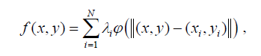
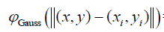
Implementation – RBF Technique Process
Selection of Centers(xi,yi) on the data
Generating a uniformly N random (min,max)
Finding the step size i.e
(Xmax - Xmin)/N
2. Selection of sigma ( for Gaussian and Multiquadric )
3. Calculation of Activation Function
4. Calculation of weight Lambda
5. Calculation of Interpolation f(x,y)

Slide 10
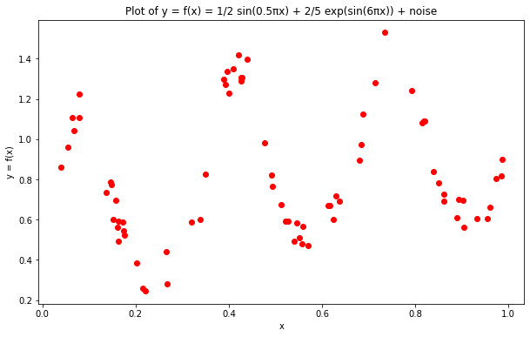
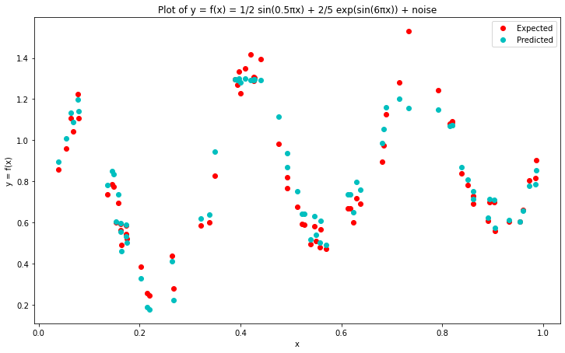
Implementation – 1D RBF
Trigonometric and nonlinear equations using gaussian RBF
RBF Interpolation 1D: Gaussian- Avg Absolute Error= 0.046773937953307906

Slide 11
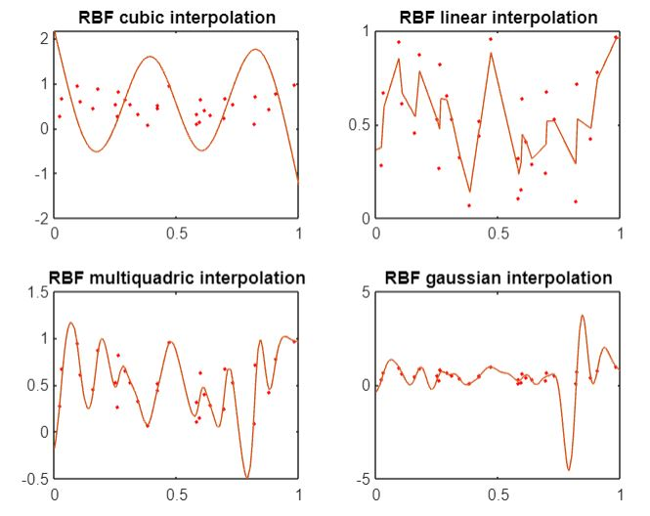
Implementation – 1D RBF

Slide 12
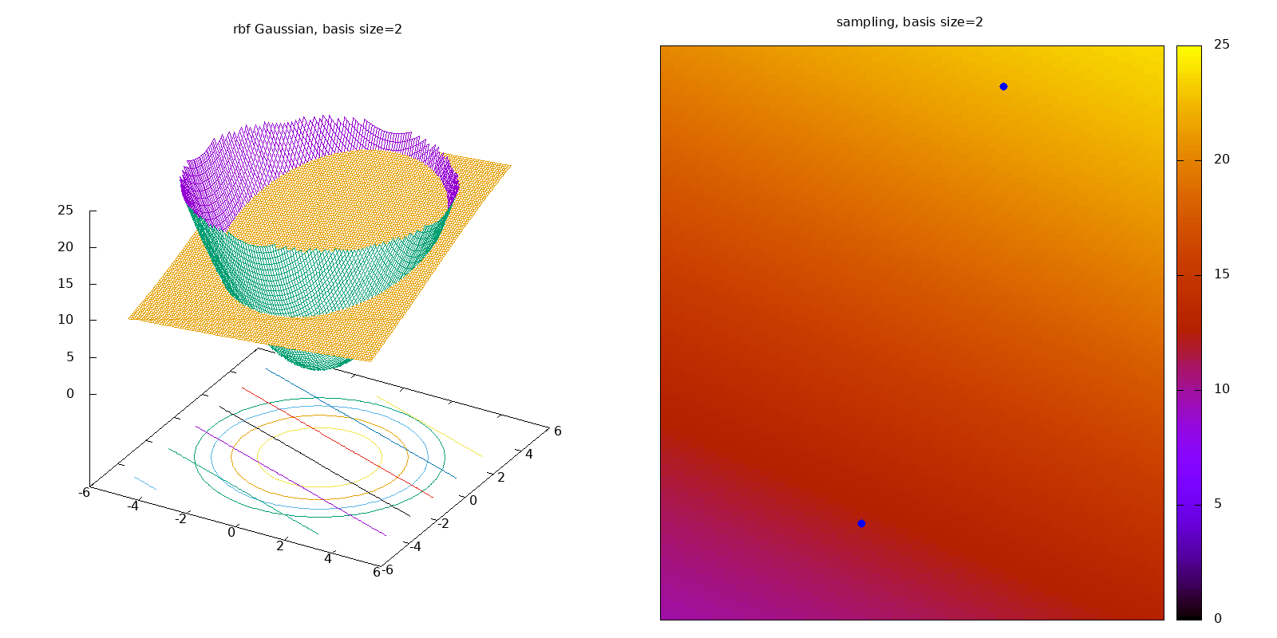
Implementation – 2D RBF

Slide 13
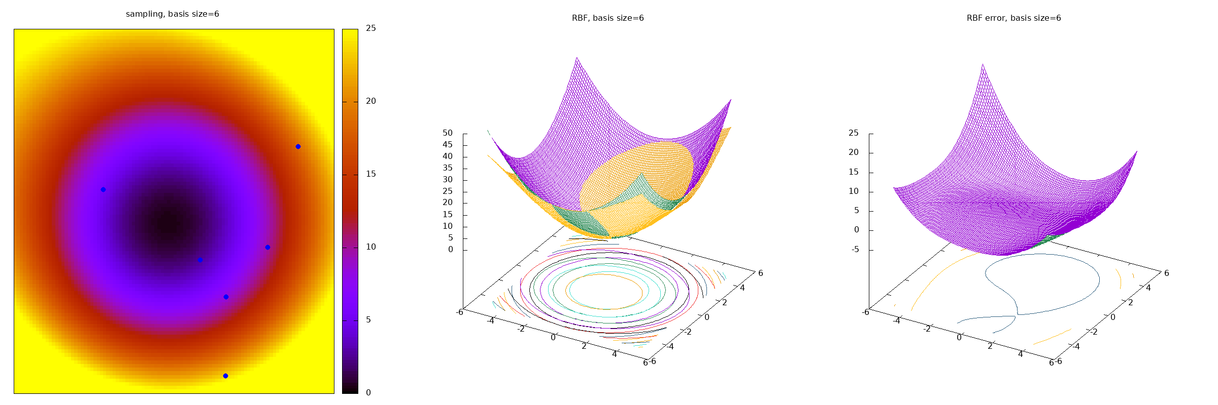
Implementation – 2D RBF

Slide 14
Results

Slide 15
Synthetic Data Results
It contains 501 X 60, where the amplitude (Dg) has 30060 entries, the traces(t) have 501 and the offset has 60.
We got the results for 10%, 20%, 30%, 40%, 50%, 60%, 70%, 80%, and 90%.

Slide 16
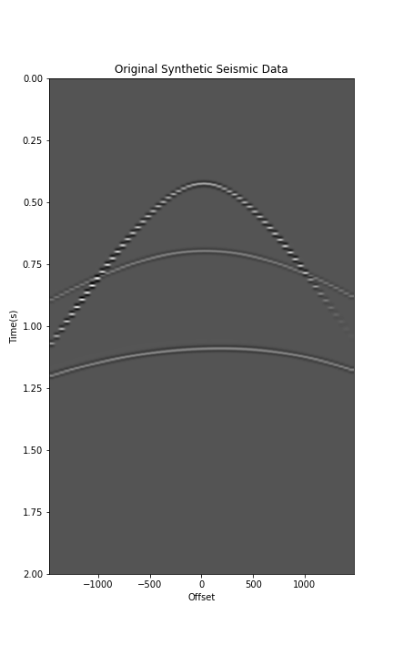
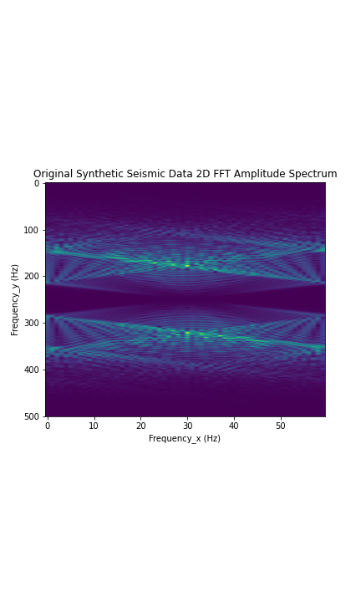
Results – Synthetic Seismic Data

Slide 17
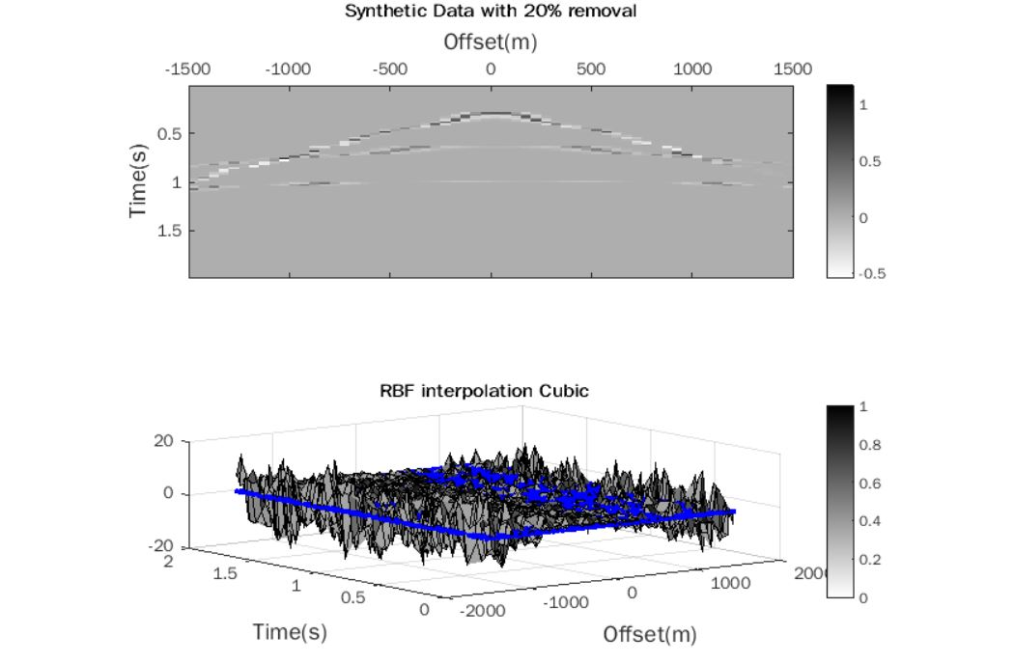
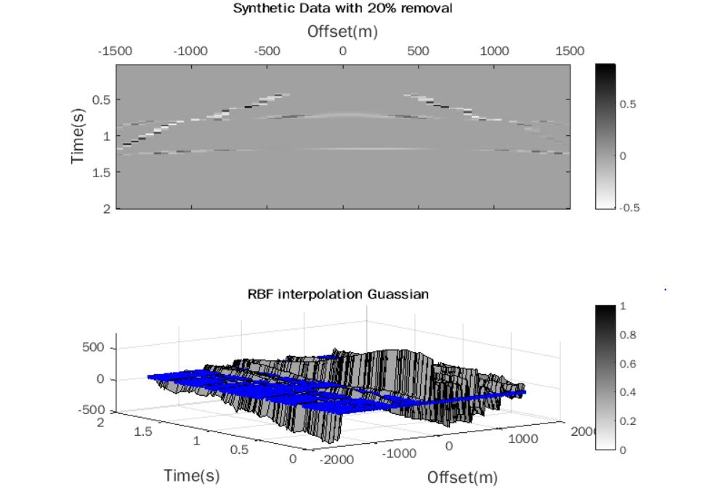
Checking for Best RBF Interpolation
RBF Interpolation Cubic 2. RBF Interpolation Gaussian ( Best Performance )

Slide 18
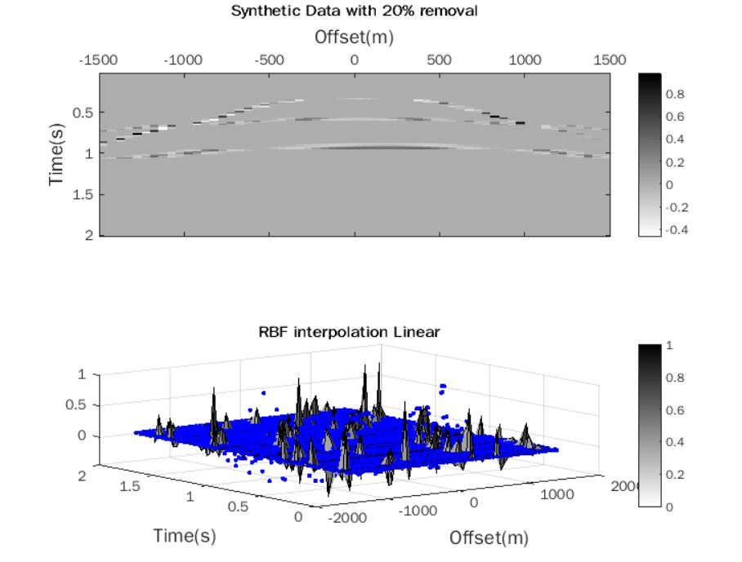
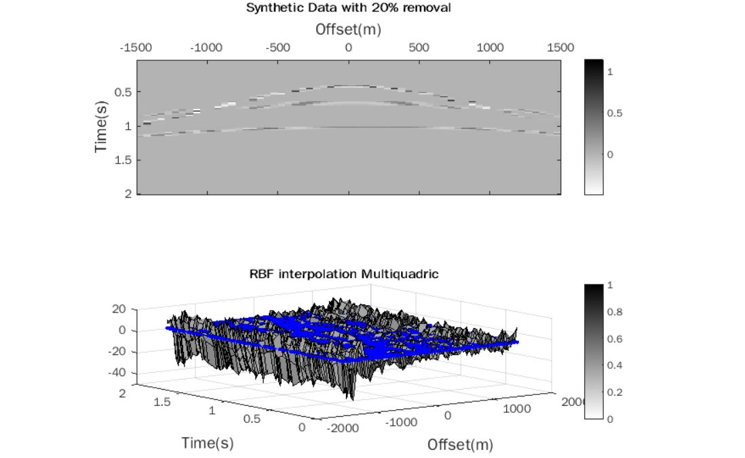
Checking for Best RBF Interpolation
3. RBF Interpolation Linear 4. RBF Interpolation Multiquadric

Slide 19
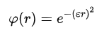
Selected RBF Methods
Gaussian RBF Methods ( MatLab )
Wendland (Compactly Supported Radial Basis Function)
𝜑ₛ(r) = (1 - r)ˢ₊

Slide 20
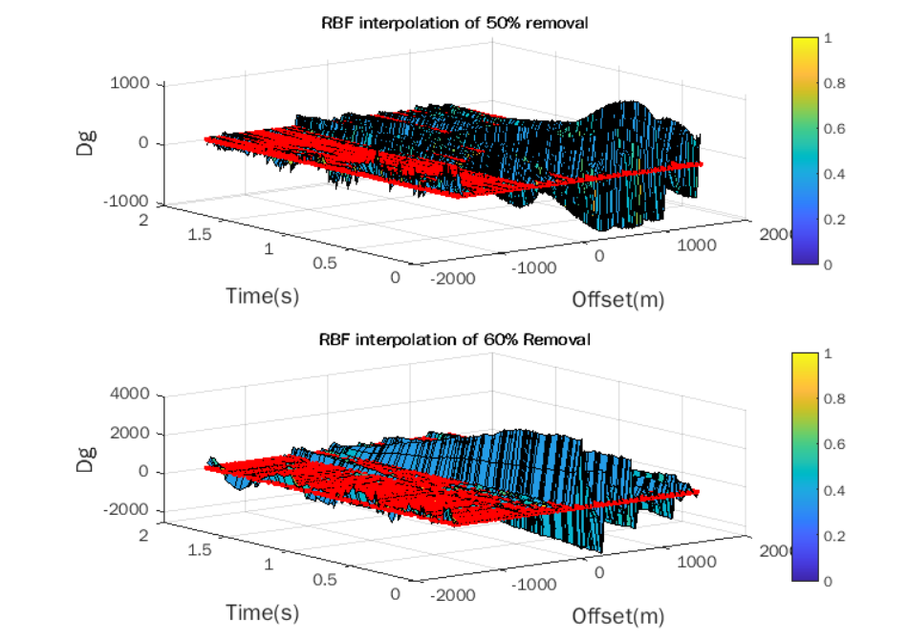
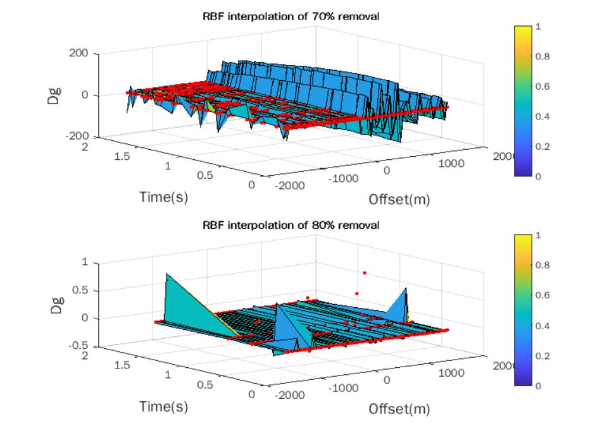
Gaussian Method

Slide 21
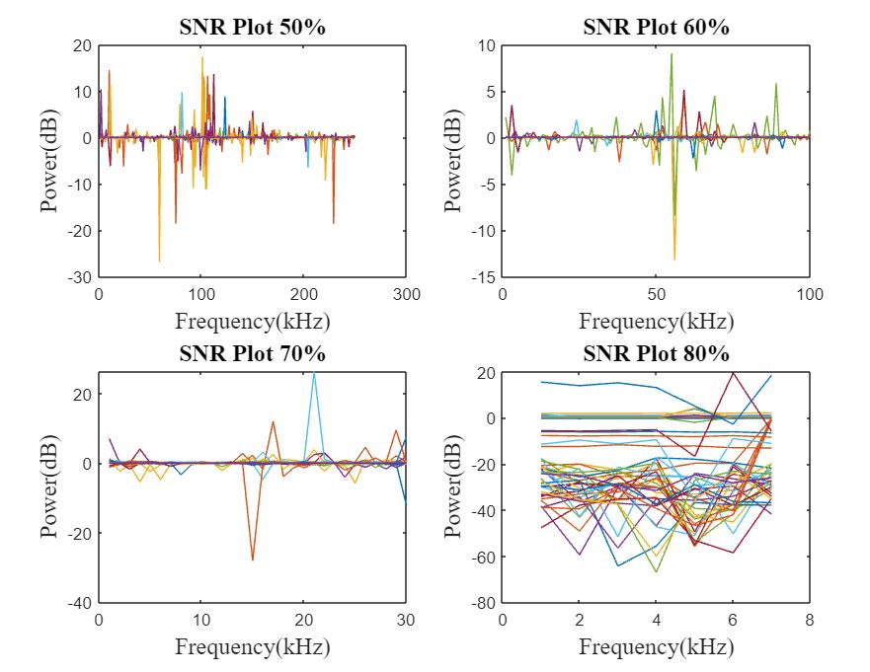
SNR Plot Using Gaussian Method

Slide 22
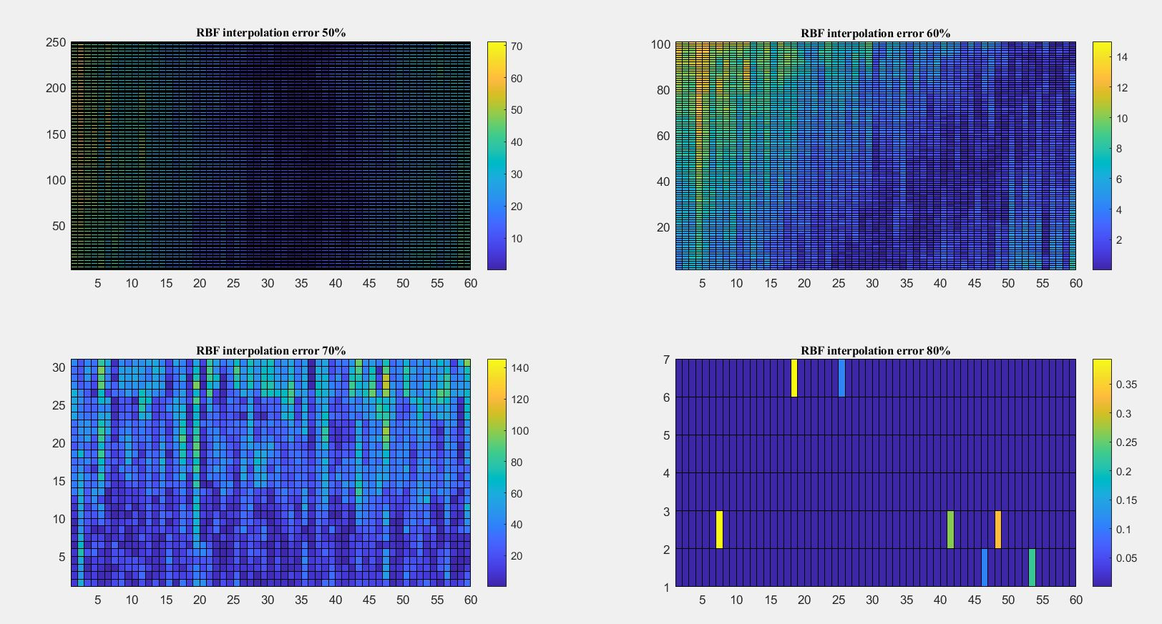
Gaussian Method Interpolation Error

Slide 23
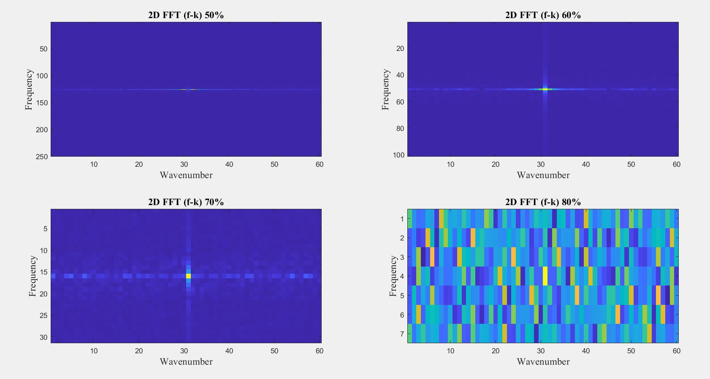
2D FFT - Plot ( Gaussian )

Slide 24
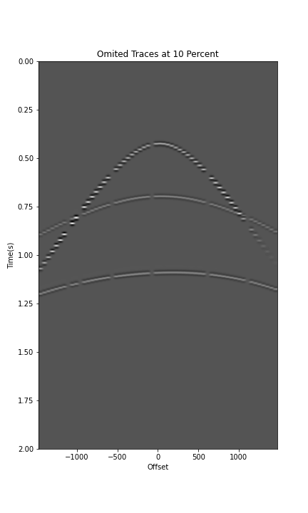
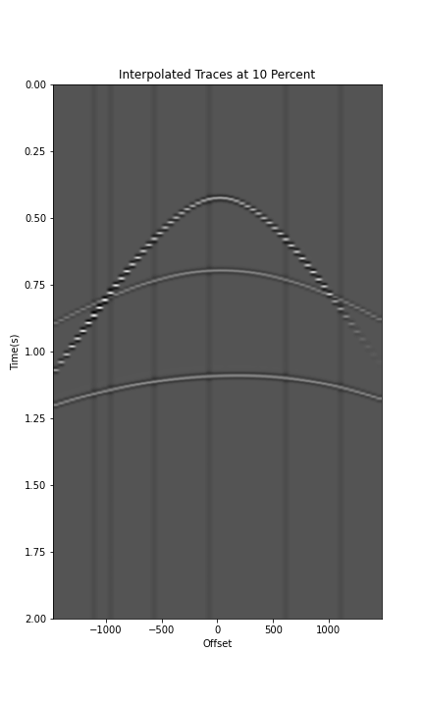
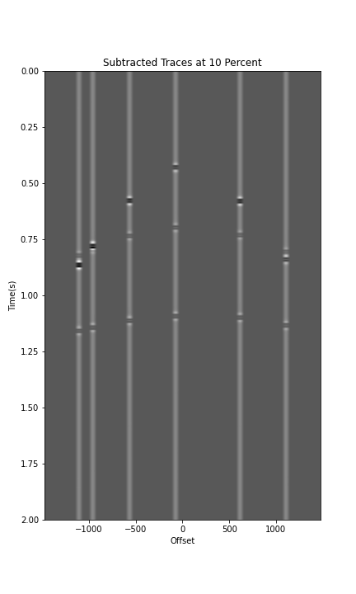
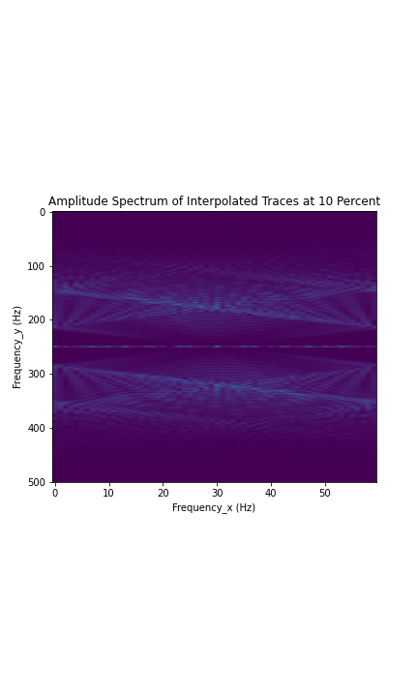
Results – Synthetic Seismic Data Removal

Slide 25
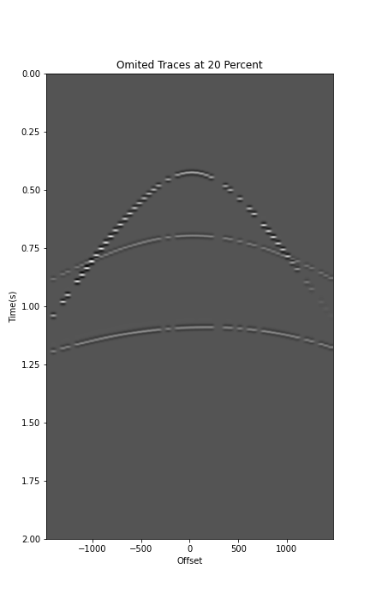

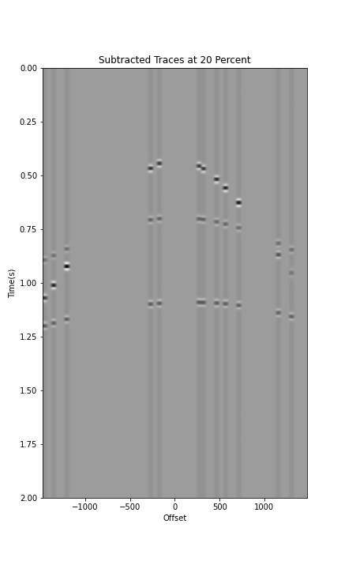
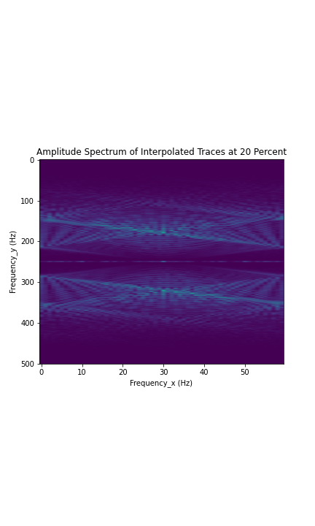
Results – Synthetic Seismic Data

Slide 26
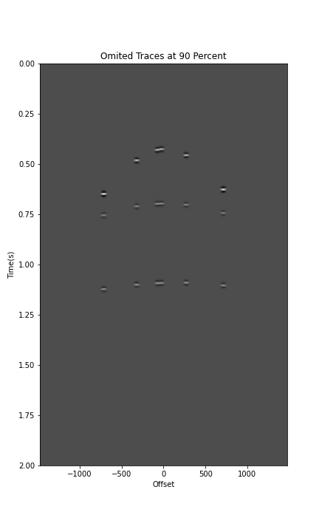

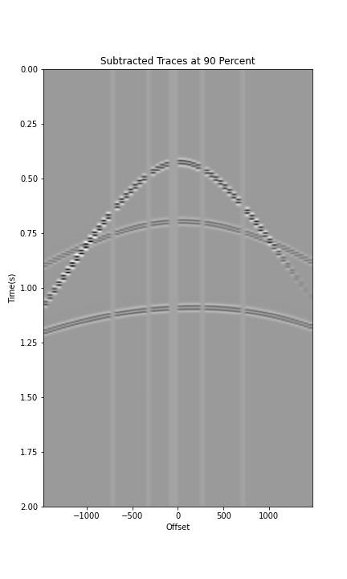
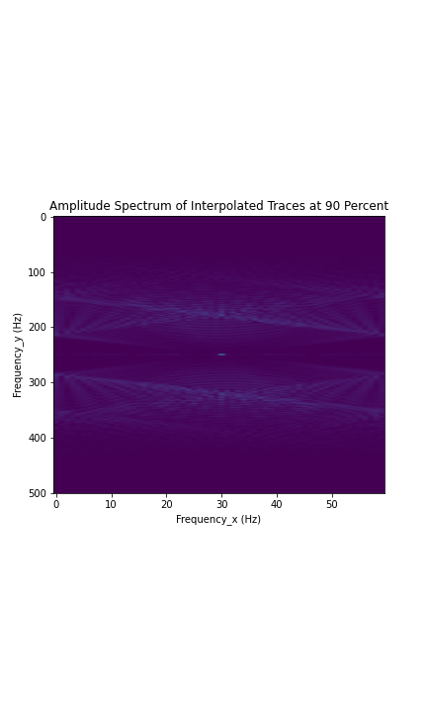
Wendland Method

Slide 27
Real Data Results
Real data - It contains 2001 X 96, where the amplitude (Dg) has 192096 entries, the traces(t) have 2001 and the offset has 96.
We got the results for 10%,20%,30%,40%,50%,60%,70%, 80% and 90%.

Slide 28
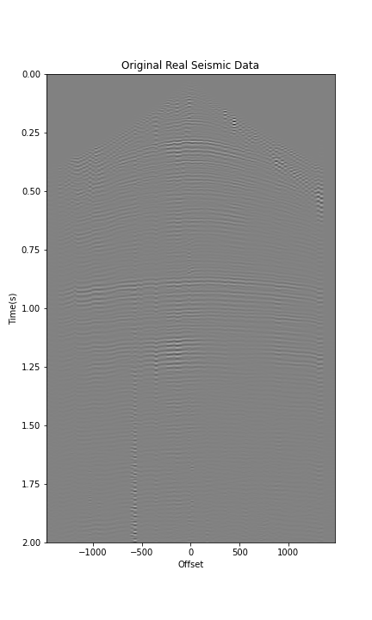
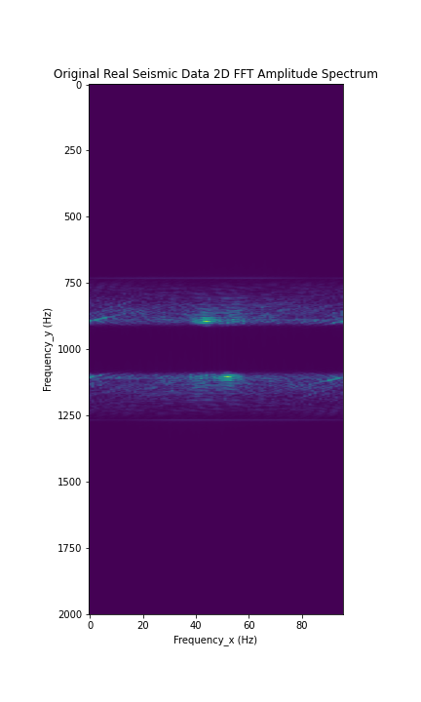
Results – Real Seismic Data

Slide 29
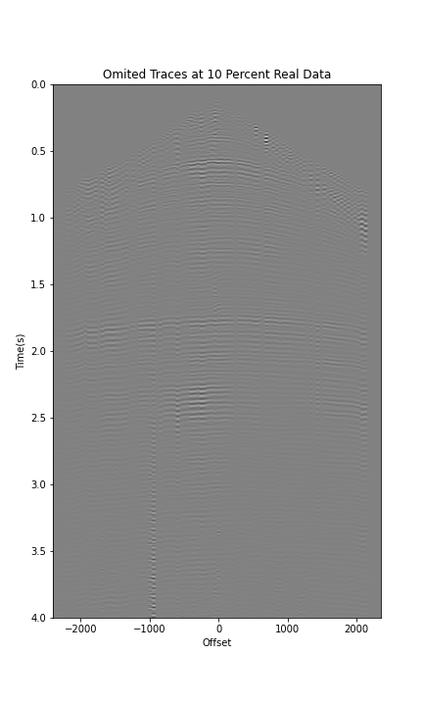
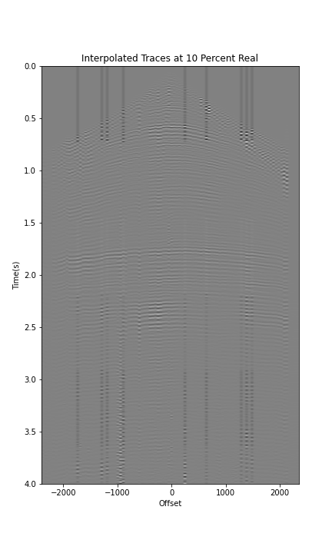
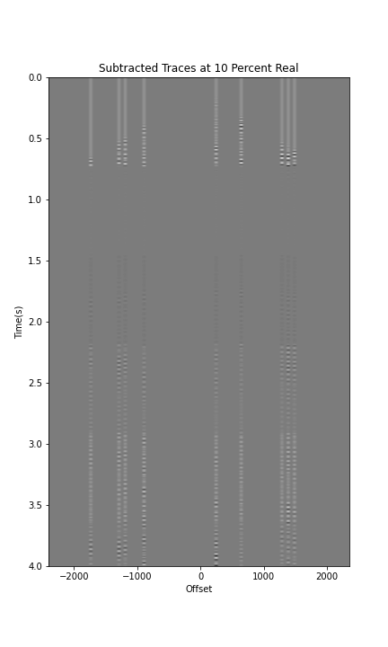
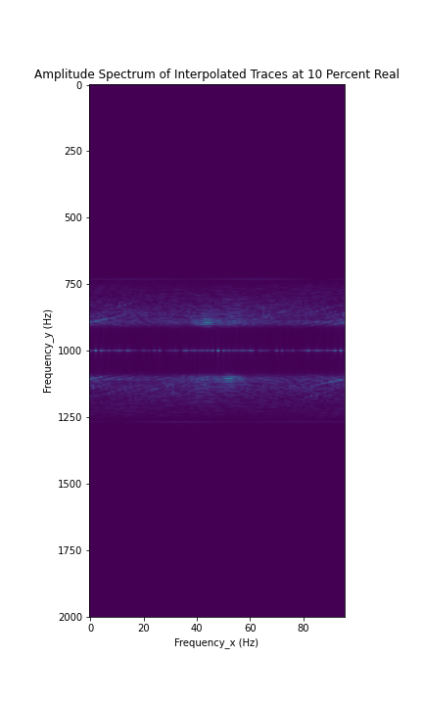
Results – Real Seismic Data Removal

Slide 30
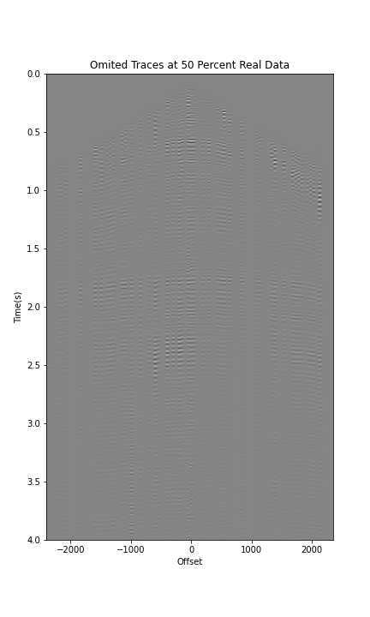
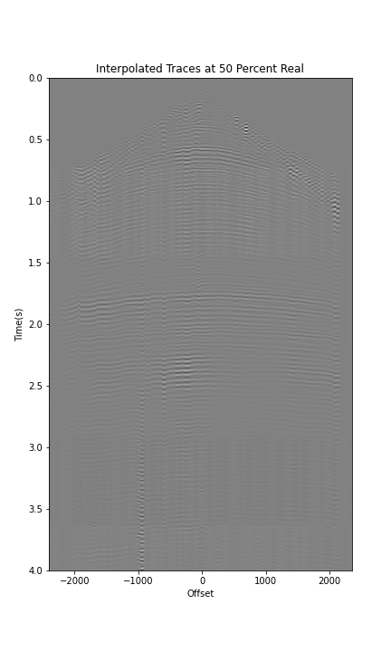
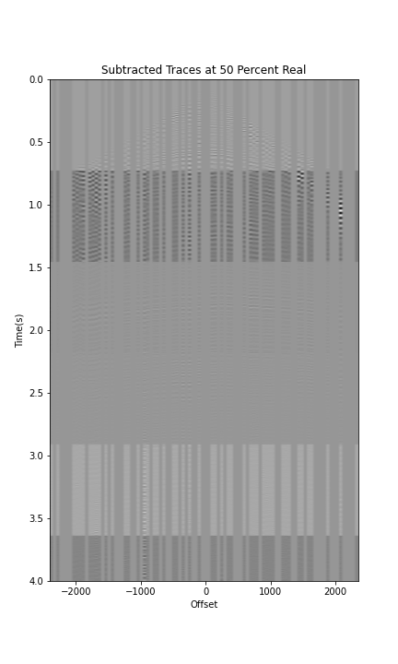
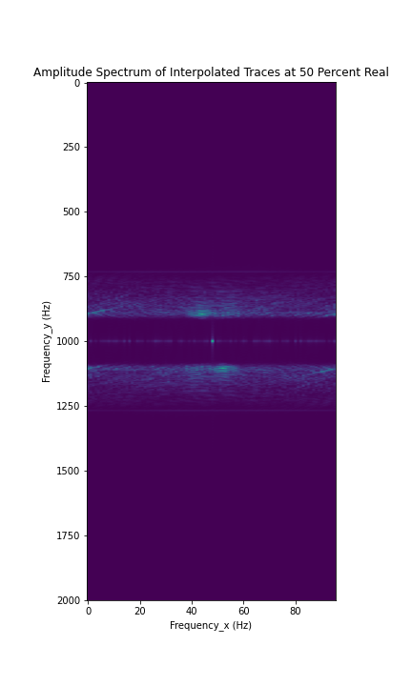
Wendland Method

Slide 31
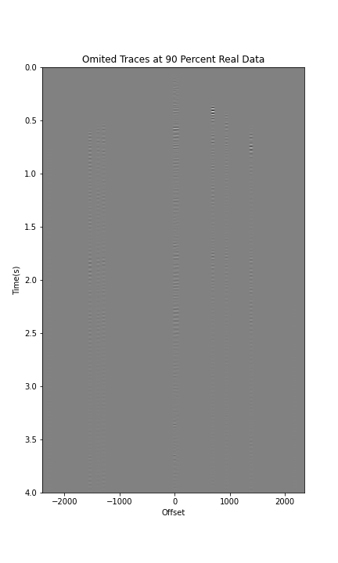
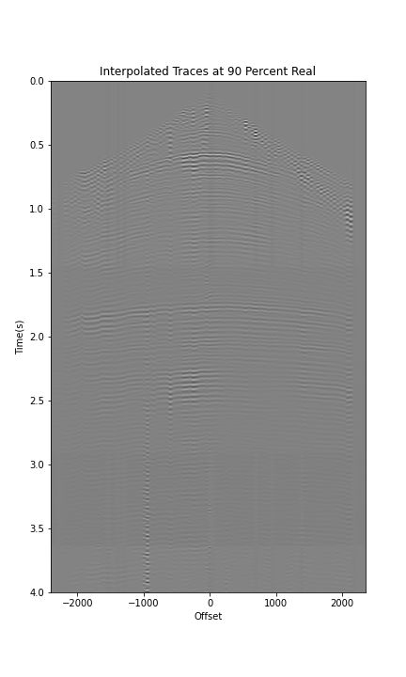
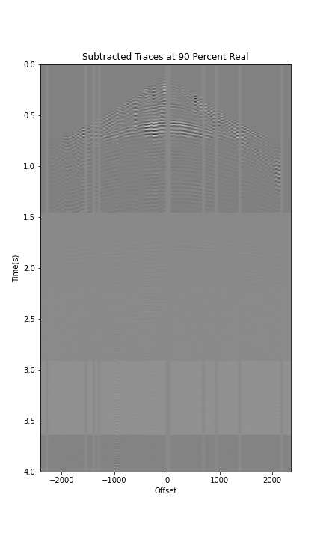
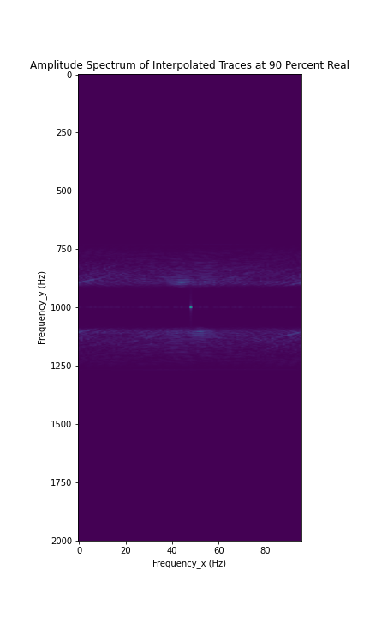
Results – Real Seismic Data

Slide 32
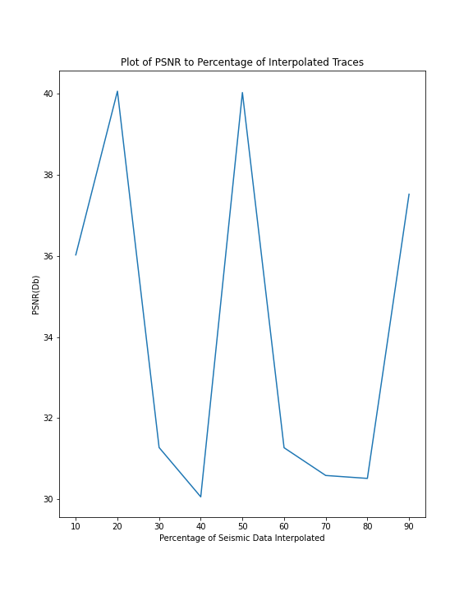
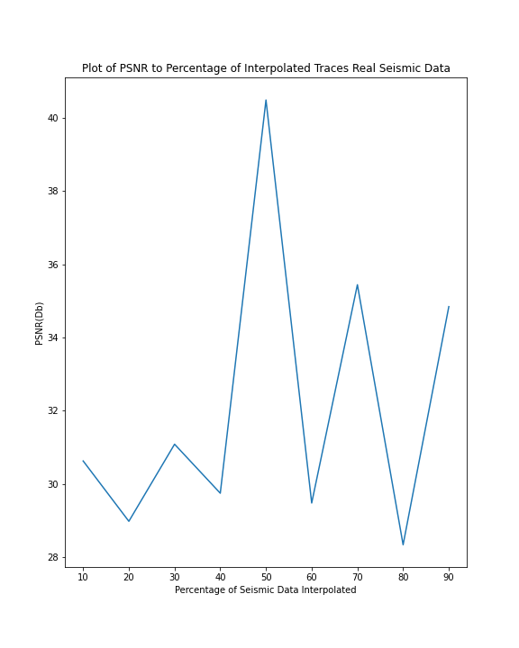
Results - PSNR

Slide 33
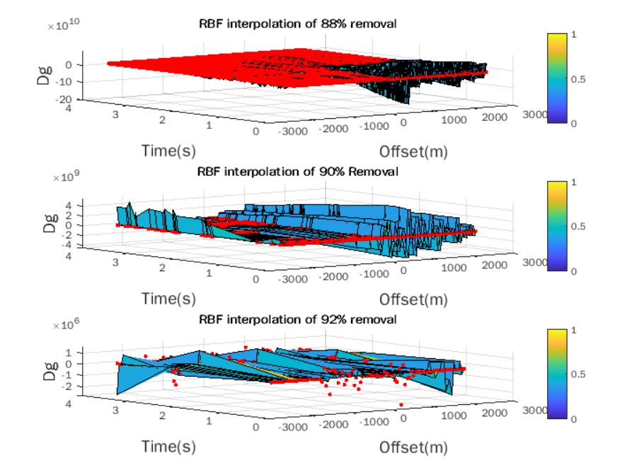
Gaussian Method - Interpolation Results

Slide 34
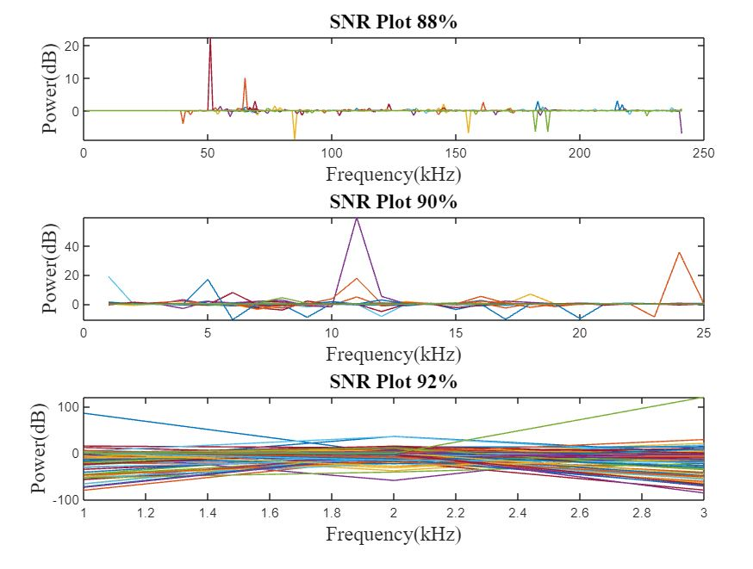
SNR Results - Real Data ( Gaussian )

Slide 35
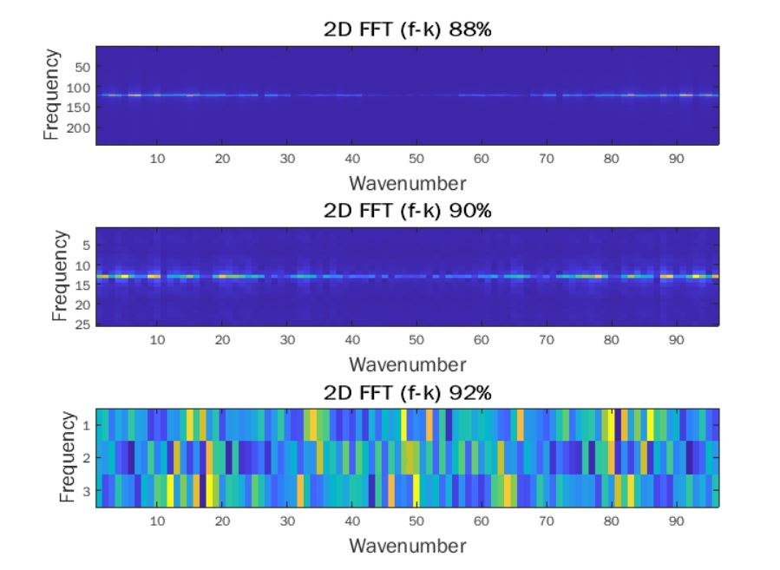
2D FFT Results ( Gaussian )

Slide 36

Comparison with Standard ( Griddata )
We compare the results with the griddata ( Cubic ) interpolation method

Slide 37
Synthetic Data Results - RBF Interpolation Gaussian

Slide 38

Conclusion
Training was Long due to high Number of data to Compute and since RBF involves Matrix Inversion
Conversion to Square Matrix challenge
In comparison with griddata, the results looks similar but not as perfect as the griddata

Slide 39


Thank You
We would be sharing our report and code soon for your consumption 😁.
Any Questions?

